Slide 1
Four of a Kind: DNS Anti-Abuse and Stability Programs
Rod Rasmussen
APWG

Slide 2

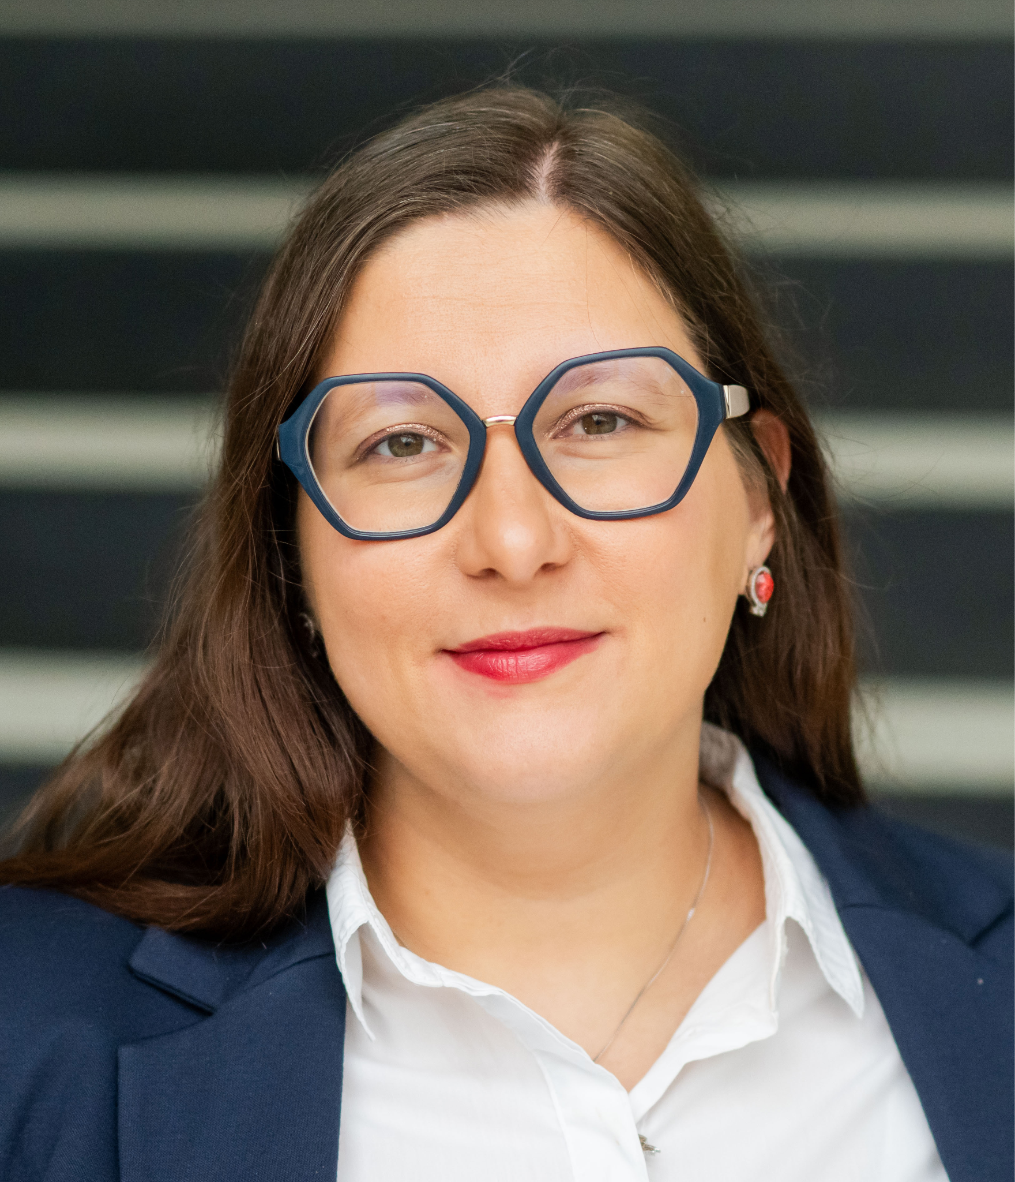
Julija Kalpokienė
Policy Consultant
Internet & Jurisdiction Policy Network (I&JPN)
Internet Infrastructure Forum (IIF)

Slide 3
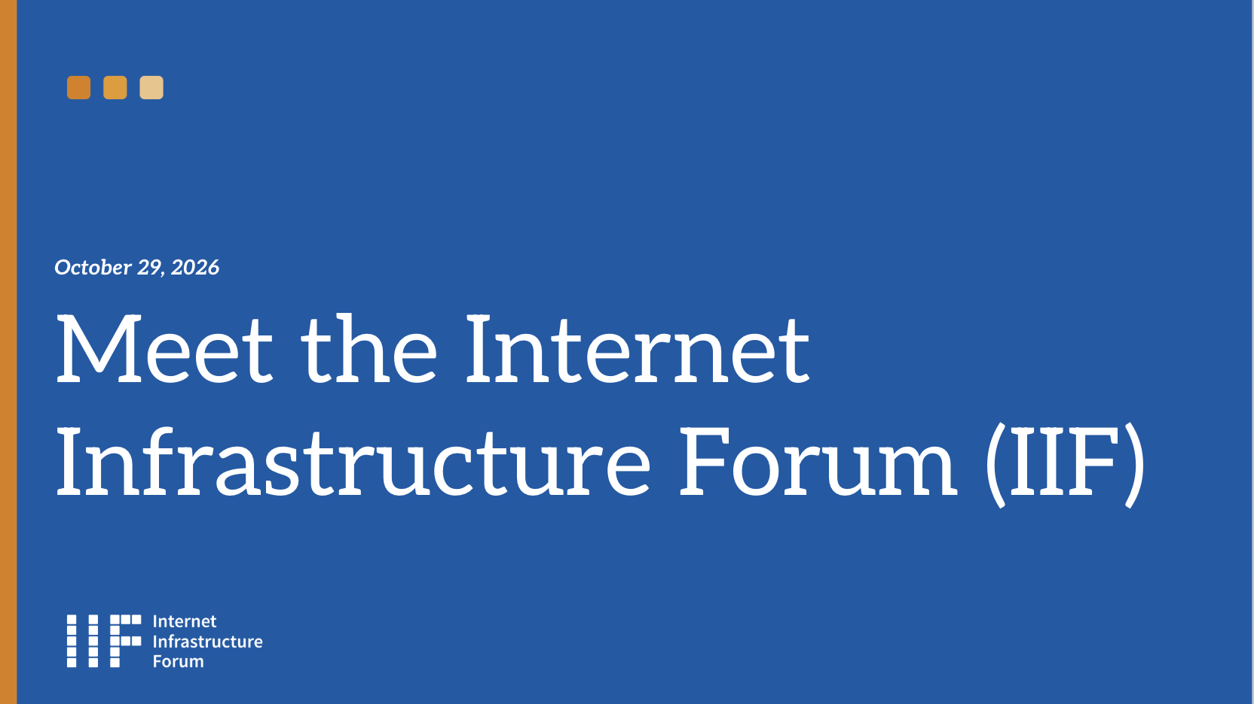

Slide 4
01.
Why the Internet Infrastructure Forum (IIF)?
02.
How is it organized?
03.
What does it address?

Slide 5
Significant abuse of the services of internet infrastructure operators by malicious actors
Increased expected role of operators in mitigation but the distributed ecosystem means siloed actions
Obligation to strengthen coordination across the stack if we want to efficiently address online harms, particularly deceptive exploitation of people
Need for a new space allowing these actors to meet
WHY

Slide 6
An industry-led initiative launched in 2025 by I&JPN, in partnership with eco and i2C
Bringing together responsible operators registries, registrars, hosting providers, and CDNs
Who adhere to a set of principles and mutual commitments
In-person meetings (2 per year) + thematic groups on issues of common interest
HOW

Slide 7
Helping improve abuse notices processing and routing workflows, in particular by encouraging automation
Developing common understanding and approaches on specific problems (e.g. DSA Transparency Reporting)
Creating data-sharing processes and mechanisms to speed up mitigation responses and enable proactive detection of organized campaigns
Providing an engagement platform for other actors of the abuse mitigation ecosystem, incl. public authorities
WHAT

Slide 8
THE
PRINCIPLES
1. Abuse Reporting and Management
2. Prompt and Proportionate Action
3. Responsible Information Sharing
4. Collective Coordination and Systemic Response
5. Right Actor(s), Right Action(s)
6. Confidential IIF Point of Contact
7. Continuous Improvement

Slide 9
A non-profit organization to be set up
Continued work with focus on practical outcomes and implementable solutions
Participation based on principles and alignment
Next meeting: IIF Karlsruhe in February 2027
NEXT

Slide 10
Key Takeaways
Internet services can be exploited and maliciously used by bad actors. Online abuse means real people are being exploited.
Thus improving coordination when addressing online harms is important.
IIF seeks to facilitate responsible information sharing among operators.

Slide 11
Contact
kalpokiene@internetjurisdiction.net

Slide 12
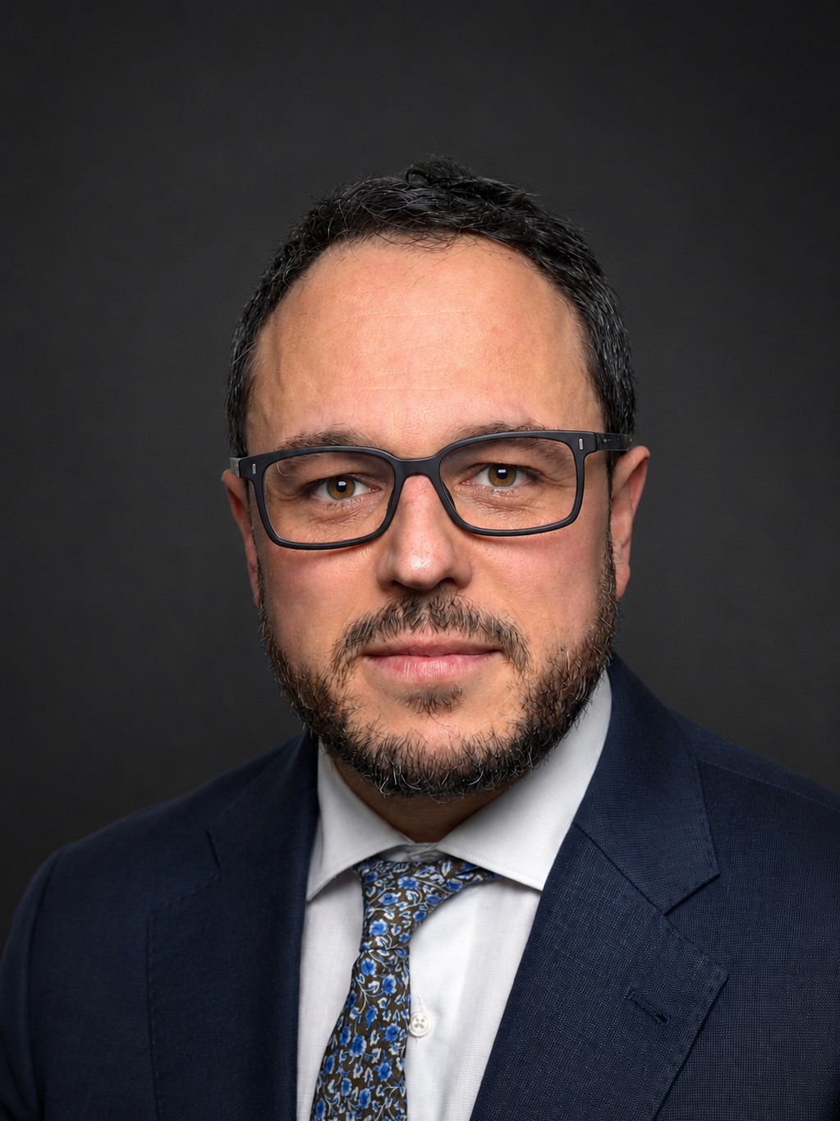
Alejandro Fernández-Cernuda
Director of Engagement
Global Cyber Alliance

Slide 13








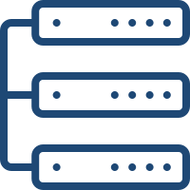








GCA’s Universe
Do Something. Measure It.
ECOSYSTEM
SYSTEMIC CYBER RISK
INFRASTRUCTURES
PARTNERS, PARTICIPANTS, SUPPORTERS
END-USERS

Slide 14








I2: Internet Integrity
Names, Numbers, and Routes
NAMES
data
NUMBERS
ROUTES
infrastructures
humans
humans

Slide 15
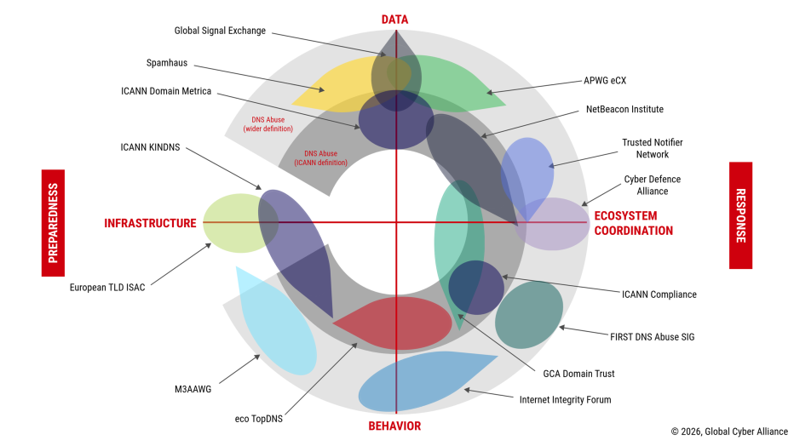
A Busy Ecosystem

Slide 16
Data, Community, Action
Background of Domain Trust
2020
Project launched as a closed, tiered information-sharing platform
Presentation at the 1st Global Anti Scam Summit (GASS)
2022
The Domain Trust Community begins its meetings
The Chatham House Rule facilitates open discussion (ICANN mitigation debates)
2024
The Community decides to enhance the platform and open it up (improved UX, a new API, and free access)
MANRS becomes a GCA project
2025
New API and UX
Ecosystem map: Domain Trust as a meeting point
The Community agrees to explore a MANRS-like initiative for Domain Trust
Increasing Openness and Maturity

Slide 17
Domain Trust Badge
Guiding Principles and Components

Slide 18

Domain Trust Badge
Guiding Principles
Positive, open, and discreet: motivation and incentives, not naming and shaming or an elite club
Support for the wider ecosystem: build on existing definitions and resources
Measure with caution: no merged datasets, private indicators, resilient to temporary campaigns
Accessible and sustainable: free, open to any size, easy to implement

Slide 19
Domain Trust Badge
Key Features
Voluntary, free and industry-led
Validates registries’ and registrars’ commitment to effective practices
Developed by the DTAWG, convened by GCA; inspired by MANRS
Actions: Policy, Coordination and Response, 17 baseline requirements
Measurement: the Domain Trust metric (DTm)
Verification and Support: the Domain Trust Badge Portal
Each requirement: evidence reviewed, weighted
Badge granted only when all requirements are met

Slide 20
Domain Trust Badge
Action Overview: Policy Requirements
POL-01 Public policy on abuse (foundational)
POL-02 Common definition of abuse (at least ICANN's)
POL-03 Public parameters for a timely response
POL-04 Human rights and freedom of speech provisions
POL-05 Review mechanisms for contested cases
POL-06 Post-incident information sharing
POL-07 Content-free detection processes
POL-08 Proactive registrant verification

Slide 21
Domain Trust Badge
Action Overview: Coordination Requirements
COORD-01 Trusted reporter via an external platform
COORD-02 Part of an information-sharing community
COORD-03 Coordination against abuse at scale (DGAs, malware, botnets)
COORD-04 Registry-registrar coordination on abuse policies
COORD-05 Dedicated point of contact with law enforcement
COORD-06 Hotlines for CSAM and other severe abuse
Most rely on platforms and tools listed in the Resource Pool

Slide 22
Domain Trust Badge
Action Overview: Response Requirements
RESP-01 Pre-delegation detection tools
RESP-02 Proactive use of threat feeds after delegation
DTm Coherent abuse indicators
  Keep the DTm above agreed values and react when performance drops
  Assessed through measurement, not a checklist

Slide 23
Domain Trust Badge
Action Overview: the Domain Trust Metric (DTm)
A single private value from 0 to 100 reflecting long-term attitude toward abuse
  Mitigation rate: share of reported abusive domains mitigated (higher is better)
  Abuse exposure: reported abuse relative to portfolio size (lower is better)
  Mitigation time: report to mitigation, if enough timestamps (faster is better)
Computed only with a minimum amount of reported abuse
12-month evaluation period, quarterly results as a check
Scaled per category (registrars, gTLDs, ccTLDs); weighted combination
Calculated by trusted data sources on their own data, sent via API
No rankings: candidates only see their position against the threshold

Slide 24
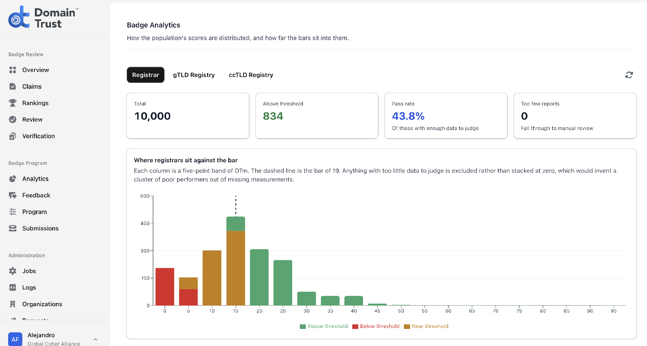
Domain Trust Badge
In a Nutshell
Domain Trust Home / Domain Trust Badge Portal / Badge Guidelines

Slide 25
Testing Stage
The Way to Implementation

Slide 26
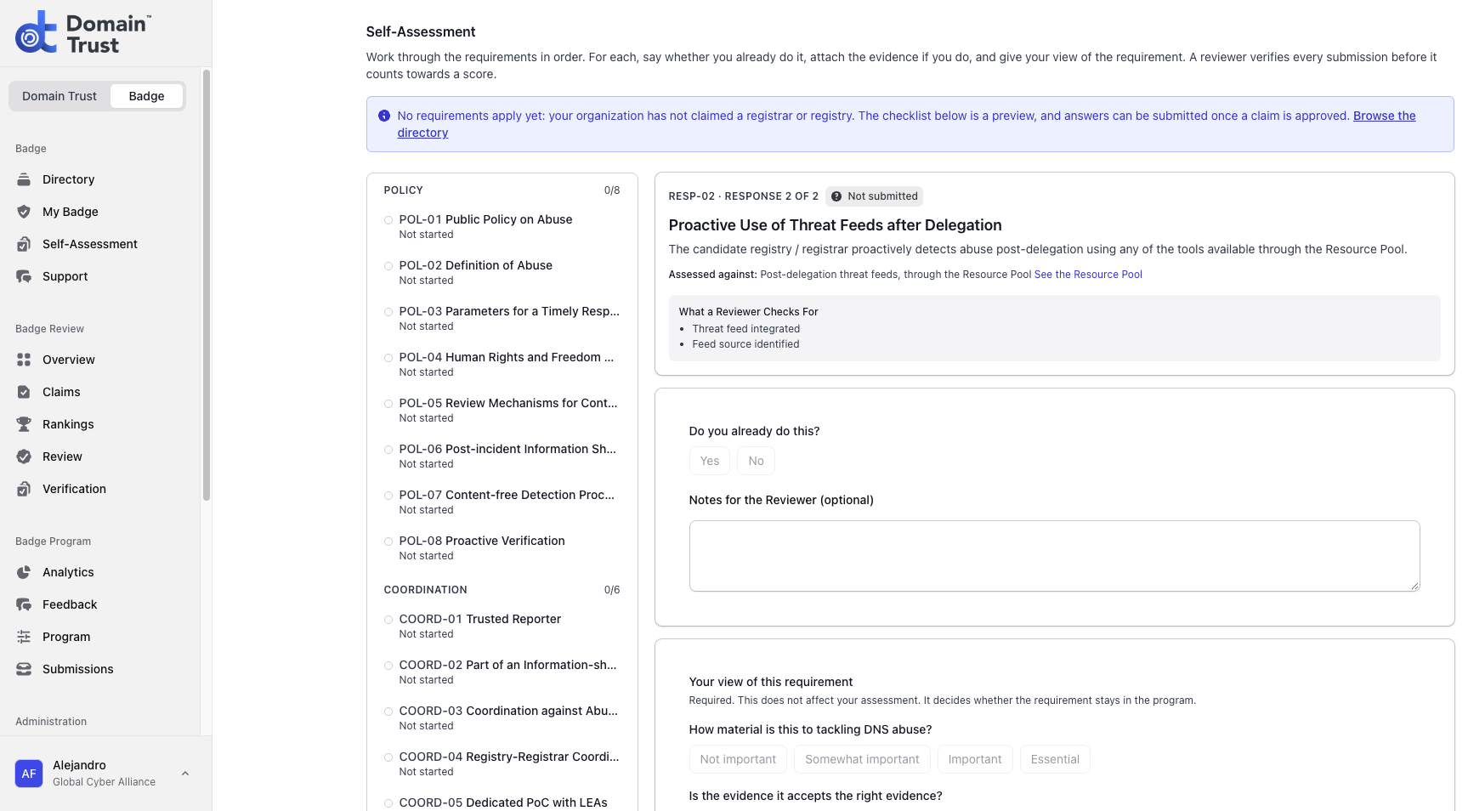
Self-Assessment Tool
(Registries & Registrars): the Validation Scheme
Validation + Feedback Collection

Slide 27
Resource Pool
Resource Pool: community-built help per requirement, still in pilot mode
The Badge as a meeting point for the anti-abuse community, where every business model and methodology is fully respected
Open call for resources:
  free or paid resources, each linked to a requirement code
  short form: organization, logo, description (up to 100 words, with link), cost
  open until February 28, 2027, then ongoing through a direct submission link
  first list published at launch, to be constantly renewed

Slide 28
Roadmap
What Is Coming Next?
Now to end 2026: Self-Assessment Tool pilot & DTm tests
Late November to mid-December 2026: DTAWG reviews test results
December 2026 to March 2027: Portal adjustments
February 28, 2027: Resource Pool call closes; submissions continue on an ongoing basis
March 2027: formal launch at ICANN 88, Lisbon
From Q2 2027: systematic work on hosting services expected to begin

Slide 29
Key Takeaways
Domain registration operators will soon have a tool to validate their anti-abuse efforts: the Domain Trust Badge
The Badge was developed by a group of operators and experts; it reflects their shared understanding of baseline anti-abuse practices
The Badge is in its final development stage and needs testers: come check it out!

Slide 30
Contact
afcernuda@globalcyberalliance.org

